Slide 1
SwagZinn – A Social Media
Hindu Institute of Management
Represented by: Vipul & Shubham

Slide 2
Contents
Introduction about the Project
Project Scheduling – Gantt Chart
Flow Chart
Screen Designs
Conclusion
Future scope
2

Slide 3
Introduction About the Project
We have build SwagZinn a social media website where users can create account and can start posting photos and follow peoples. And much more.
SwagZinn is an application which includes saving our life moments to the internet & sharing it to the world in the form of posts.
It allows people to connect to the world by following them. See their posts, like and comment on their posts.
3

Slide 4
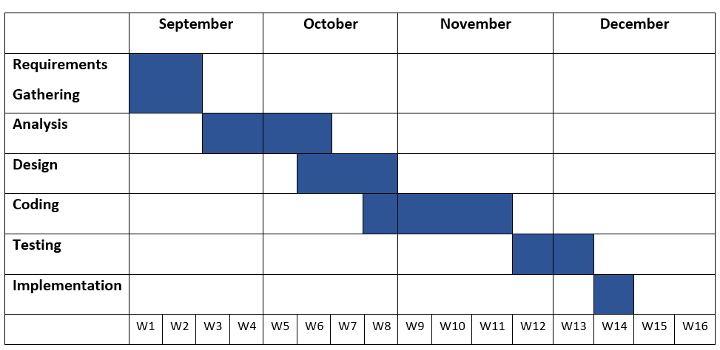
Project Monitoring (Gantt Chart)
A Gantt Chart is commonly used graphical depiction of a project schedule.
Gantt Chart
4

Slide 5
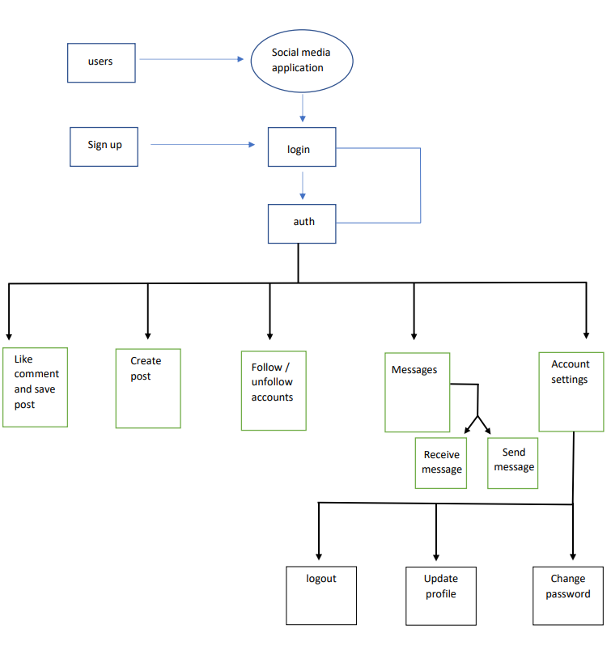
Flow Chart
A flowchart is a diagram that depicts a process, system or computer algorithm.
5

Slide 6
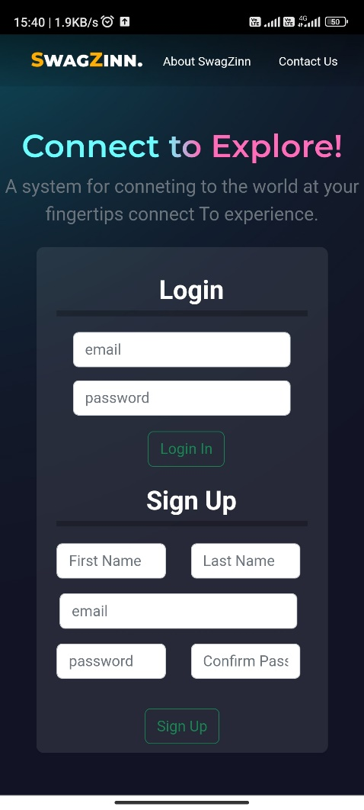
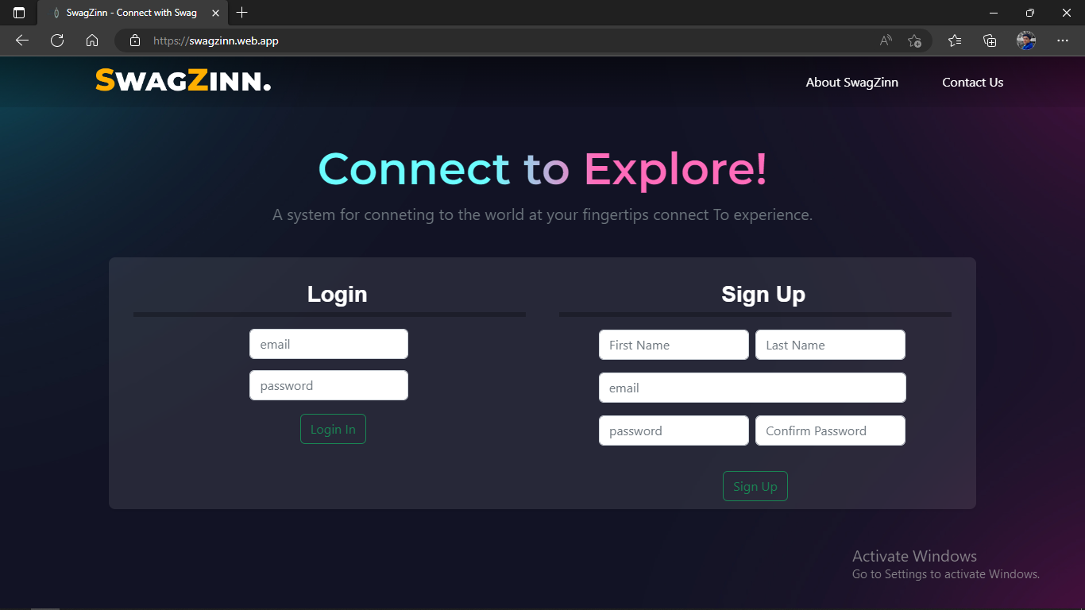
Screen Designs
1. Landing Page of SwagZinn
6

Slide 7
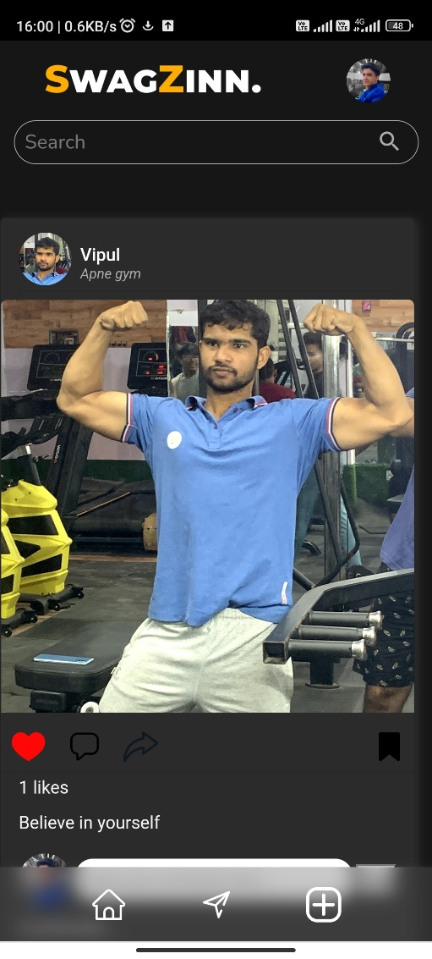
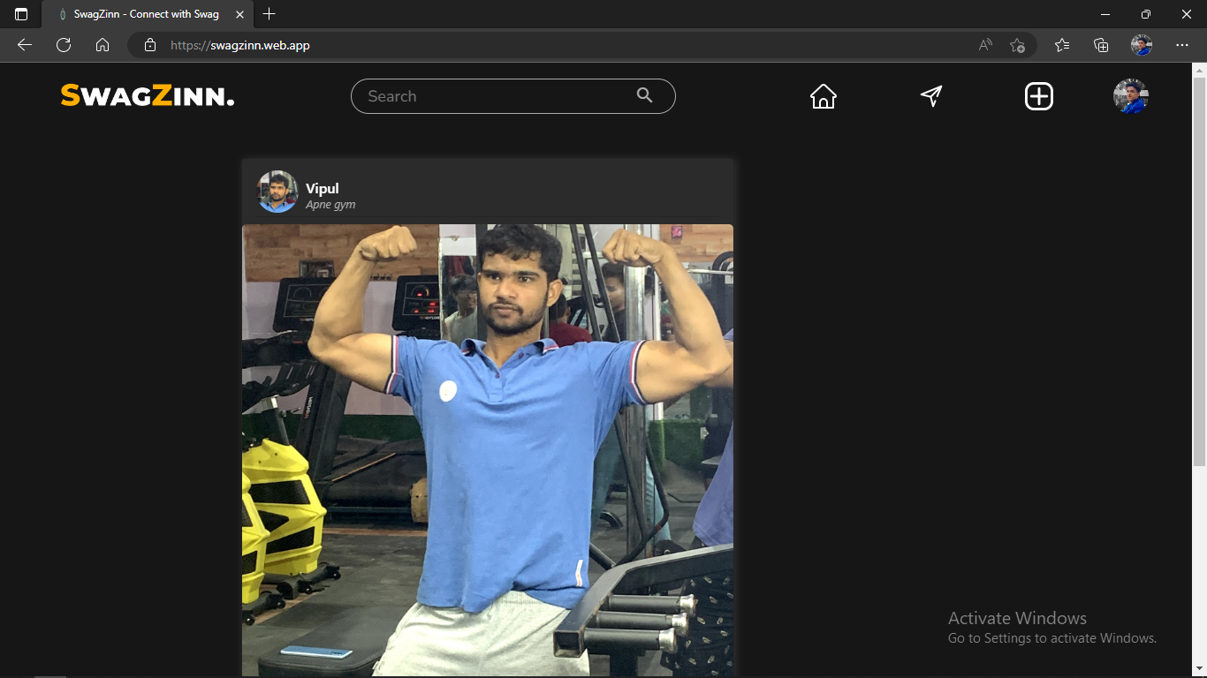
Screen Design
2. Home Page of SwagZinn
7

Slide 8
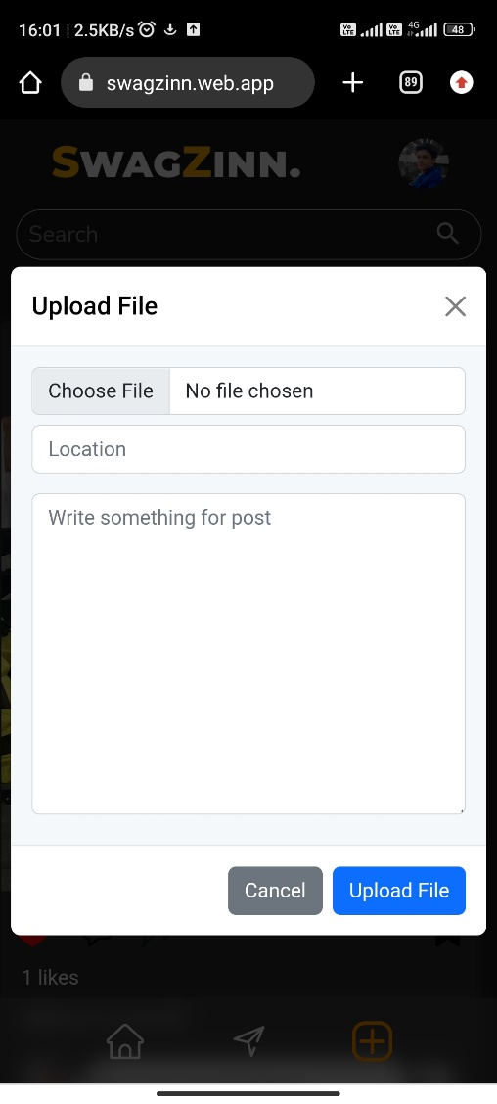
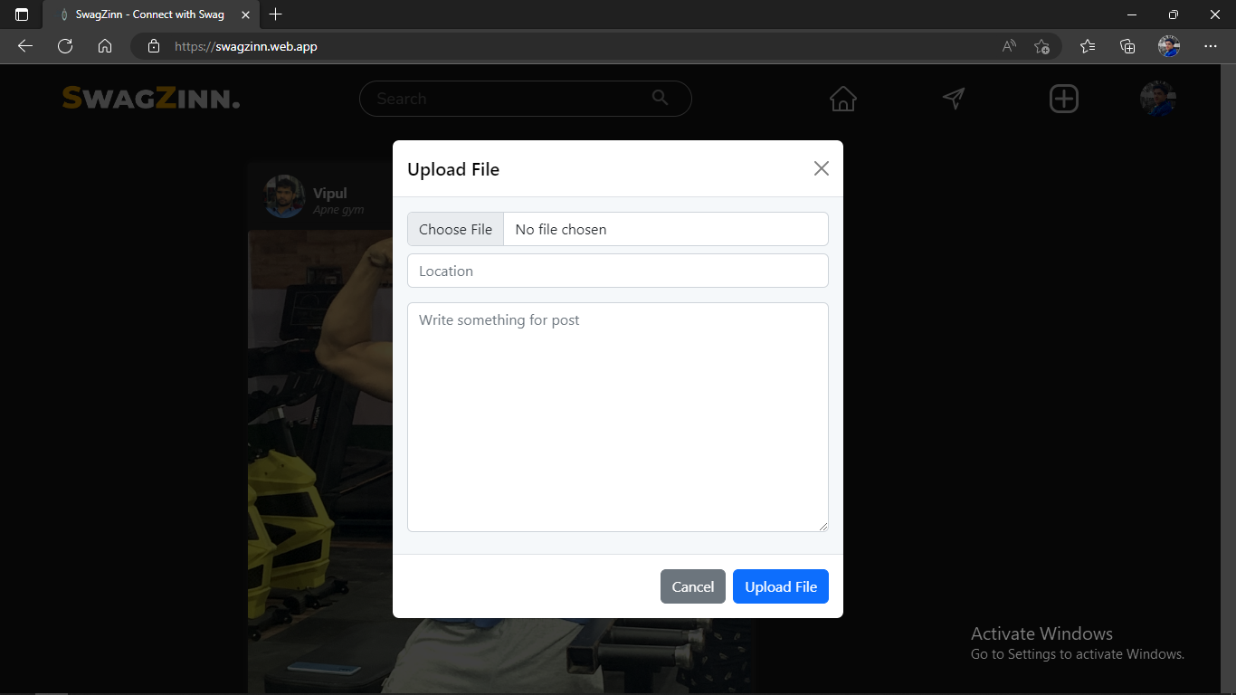
Screen Design
3. Adding Post in SwagZinn
8

Slide 9
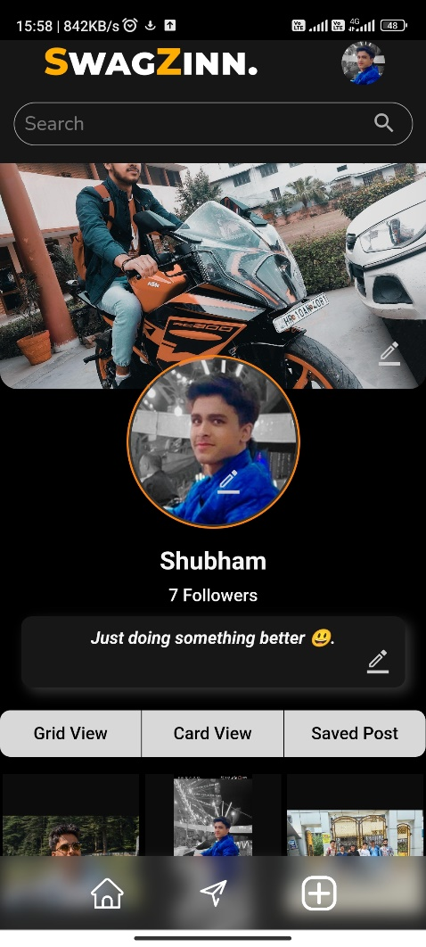
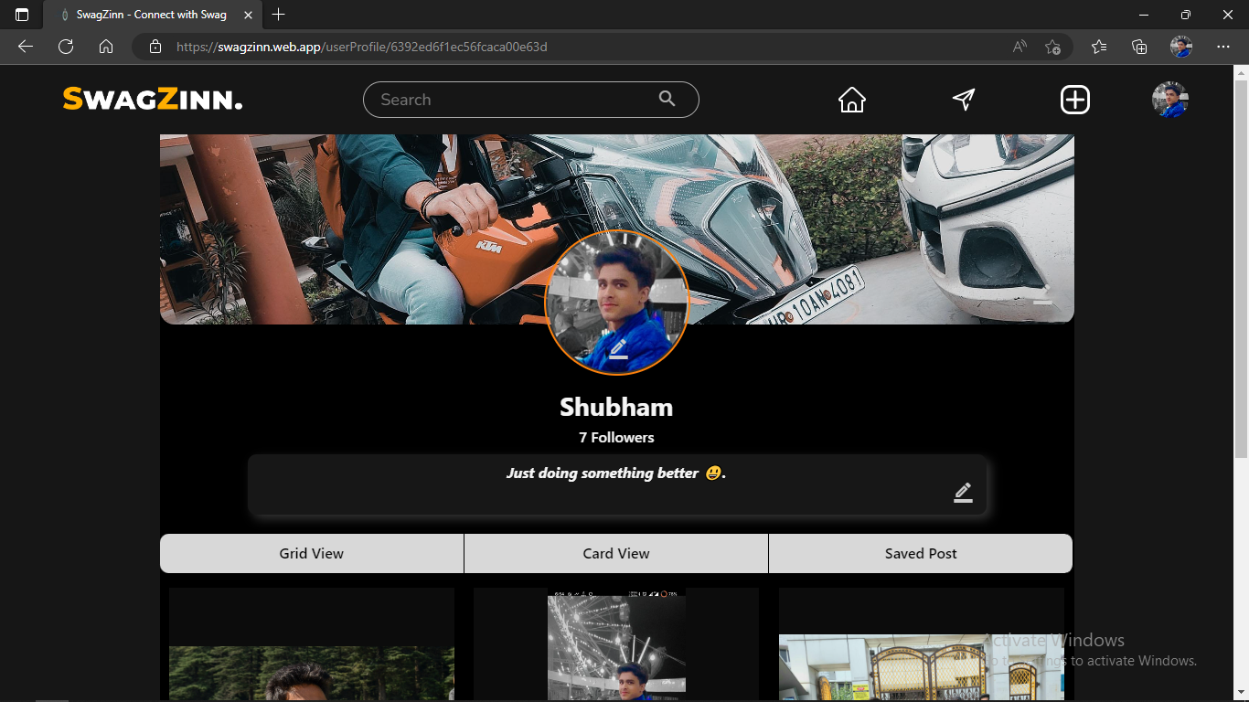
Screen Design
4. My Profile in SwagZinn
9

Slide 10
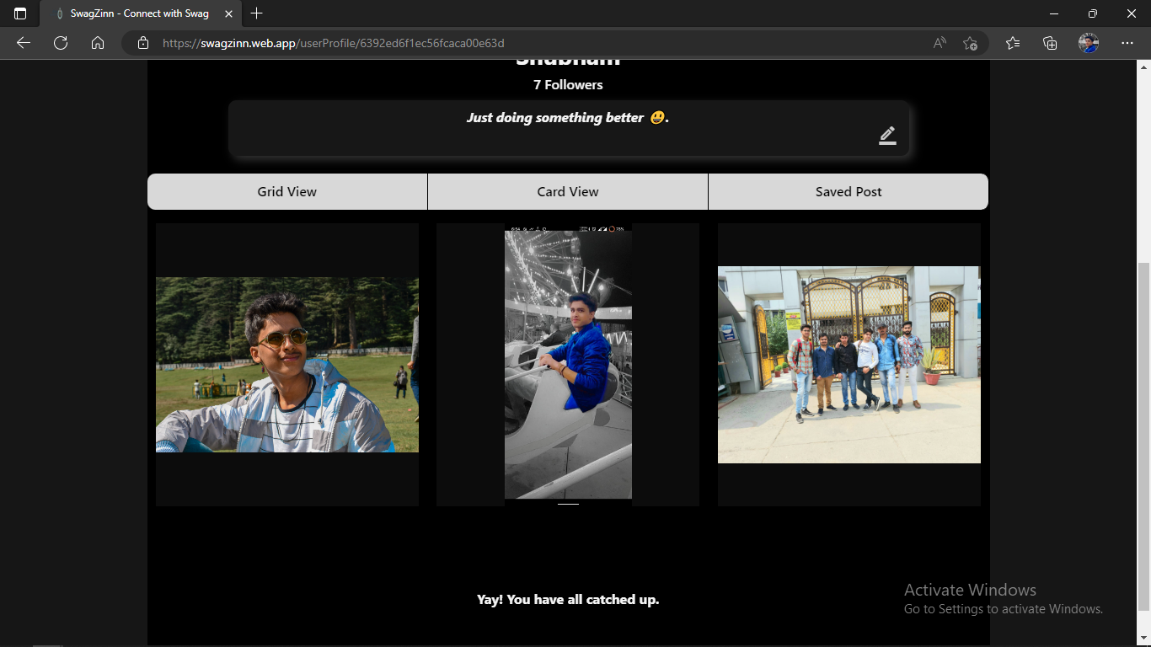
Screen Design
5. My Profile GridView
10

Slide 11
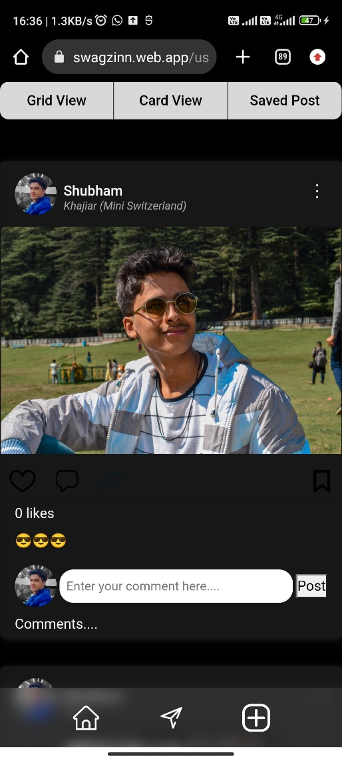
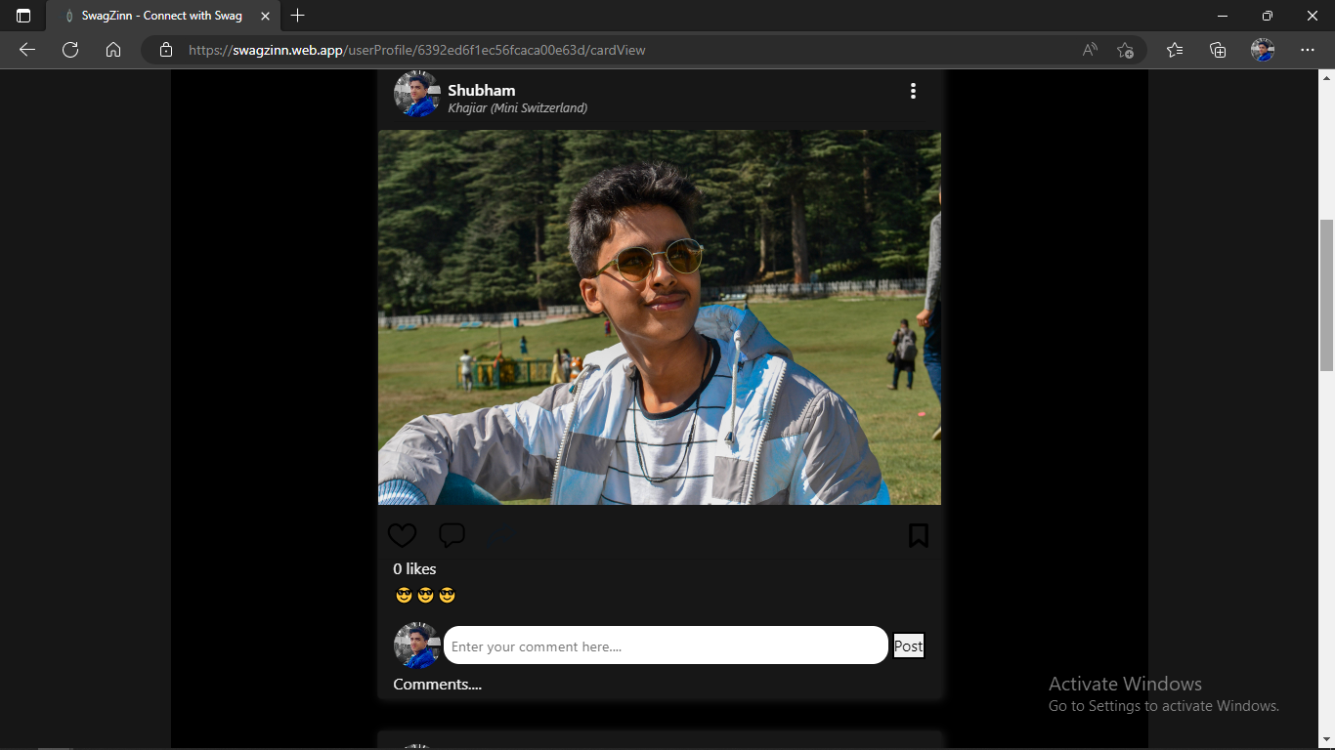
Screen Design
6. My Profile Card View
11

Slide 12
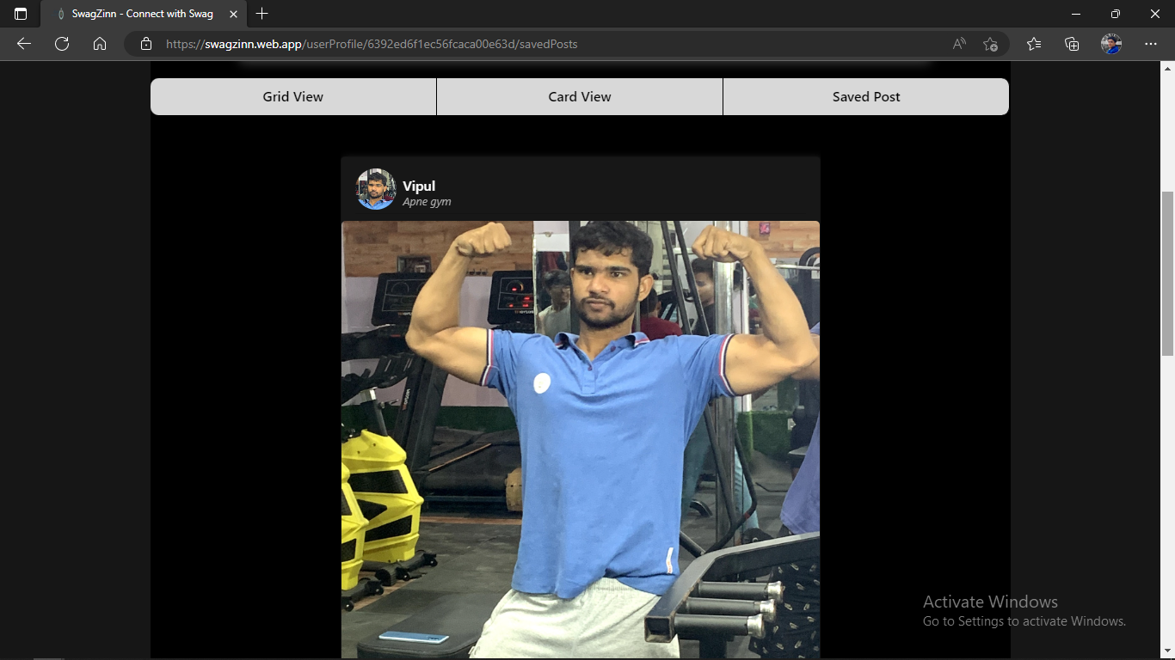
Screen Design
7. My Profile Saved Post
12

Slide 13
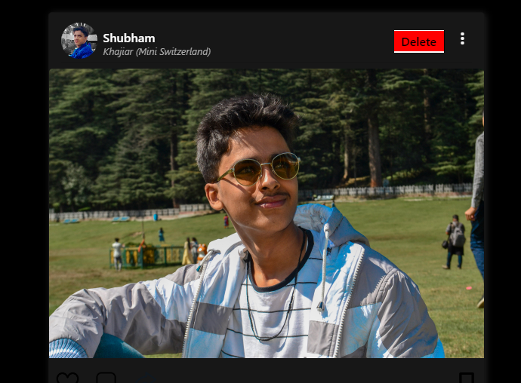
Screen Design
8. My Profile Delete Post
13

Slide 14
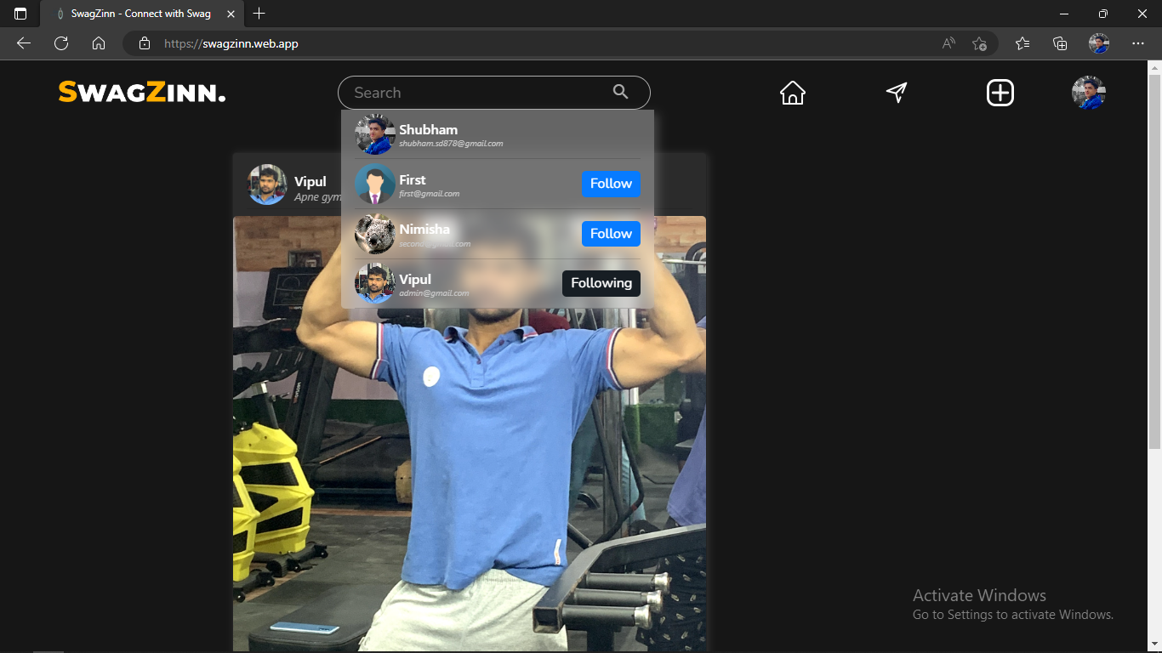
Screen Design
9. Searching Account
14

Slide 15
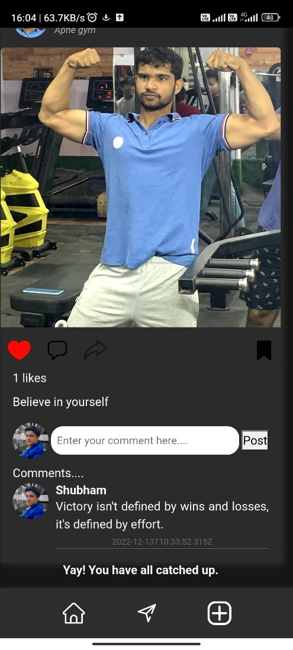
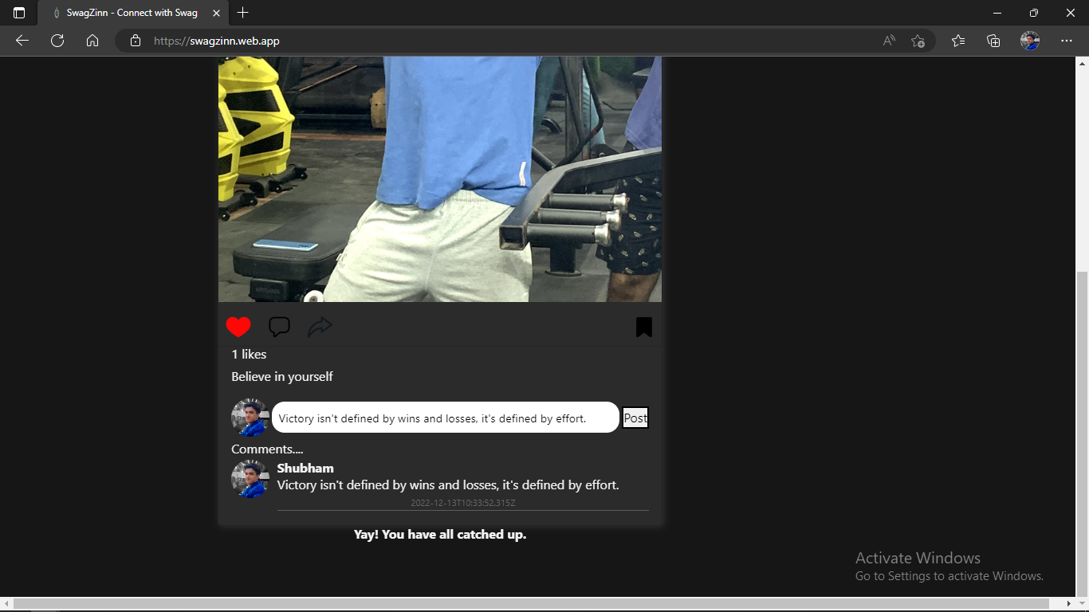
Screen Design
10. Adding Comment
15

Slide 16
Conclusion
Nowadays people don’t have time to go outside and meet the loved ones. Everyone wants an easy way to connect people.
SwagZinn is a way by which people can connect with people all over the world.
On SwagZinn people can create account and start posting their views, memories, images, posts with some additional informational content.
This project teaches us how to deal with database, how to build a system that can serve a multiple users at the same time.
It also teaches us how to deal with cookies and sessions to give users a good experience
16

Slide 17
Future Scope
We will implement Chatting Feature.
We will implement infinite scroll in Search bar.
We will add the page of trending posts (Most liked ones).
We will upgrade our project to mobile application platform.
We will add functionalities to upload videos too.
17

Slide 18
Thank You

